Slide 1
Trigger

Slide 2
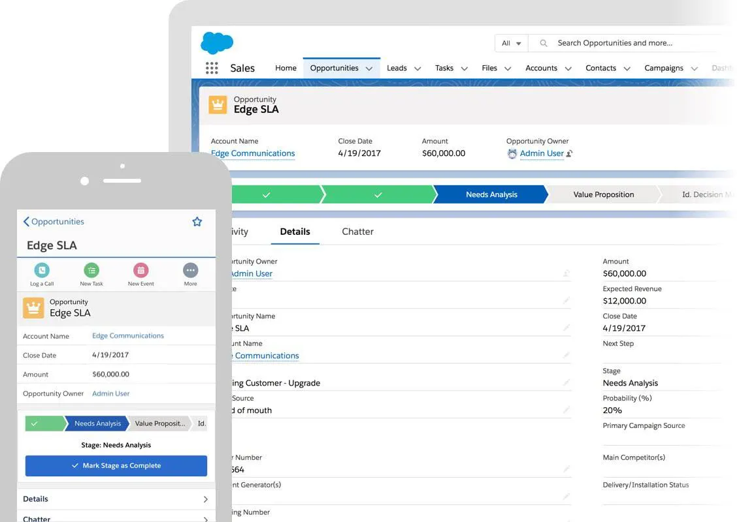




Salesforce Trigger
Default DB flow - No Trigger
User performs an operation( create, update or delete) record(s) in salesforce org
Data gets committed in the database
Default DB Flow - With Trigger
TRIGGER
TRIGGER LOGIC

Slide 3

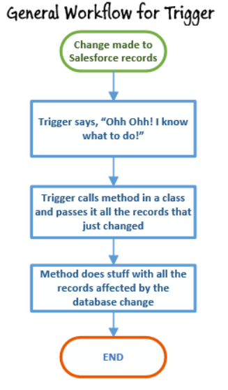
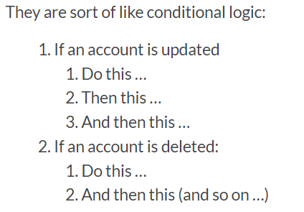
What is a Trigger
Courtesy:womencodeheroes

Slide 4

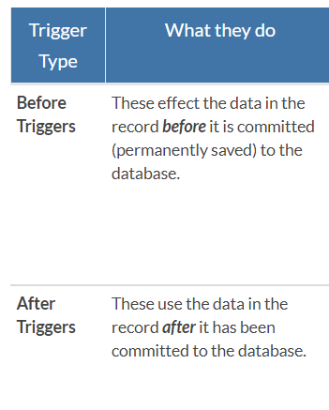
Types
Courtesy:womencodeheroes

Slide 5
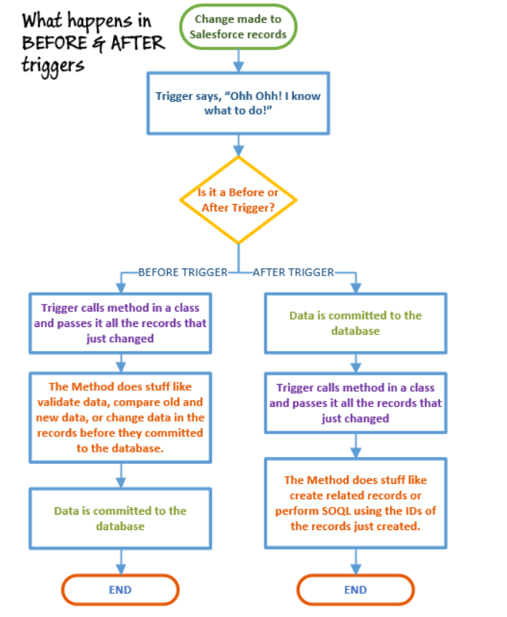



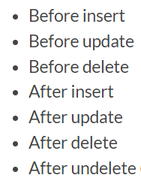
How does it execute
Courtesy:womencodeheroes

Slide 6
For Further Reading
Trailhead:
https://trailhead.salesforce.com/content/learn/modules/apex_triggers/apex_triggers_intro
Developer guide:
https://developer.salesforce.com/docs/atlas.en-us.224.0.apexcode.meta/apexcode/apex_triggers.htm
Triggers simple examples:
https://www.salesforcetutorial.com/salesforce-apex-trigger-examples/
Example to show how account record can be updated from contact trigger:
https://www.veonconsulting.com/apex-trigger-in-salesforce/
Video Tutorial :
https://www.youtube.com/watch?v=bllHYNGiJC4
Code reference:
https://github.com/SalesforceSFDC/Apex/tree/master/Apex%20Triggers
Little advanced - Refer this once you are comfortable with basics
https://www.apexhours.com/demystifying-apex-triggers/
Best practices reference:
https://www.panaya.com/blog/salesforce/apex-trigger/

Slide 7
Sample

Slide 8
trigger ContactAccountCheckTrigger on Contact (before insert, before delete, before update) {
// Run this trigger only when delete operation is initiated by the system or user
if(Trigger.isDelete) // Boolean (true only if its a delete operation
{
System.debug('I am being called during delete operation’);
System.debug('Trigger.isInsert=::' + Trigger.isInsert);
System.debug('Trigger.isDelete=::' + Trigger.isDelete);
System.debug('Printing trigger.old value:: ' + Trigger.old);
System.debug('Printing trigger.new value:: ' + Trigger.new);
for(Contact contoDelete : Trigger.old) // get contact details
{
System.debug('Printing Account ID associated to the contact=::' + contoDelete.AccountId);
if(contoDelete.AccountId !=null) //see if contact account is empty or has value
. {
contoDelete.addError('Contact has a valid accounttied to so delete is
. not possible !!! Talk to account owner please !!!’);
. }
}
}
if(Trigger.isInsert)
{
// Do something you want to do when a record is being inserted
}
if(Trigger.isUpdate)
{
// Do something you want to do when a record is being updated
}
}

